Slide 1

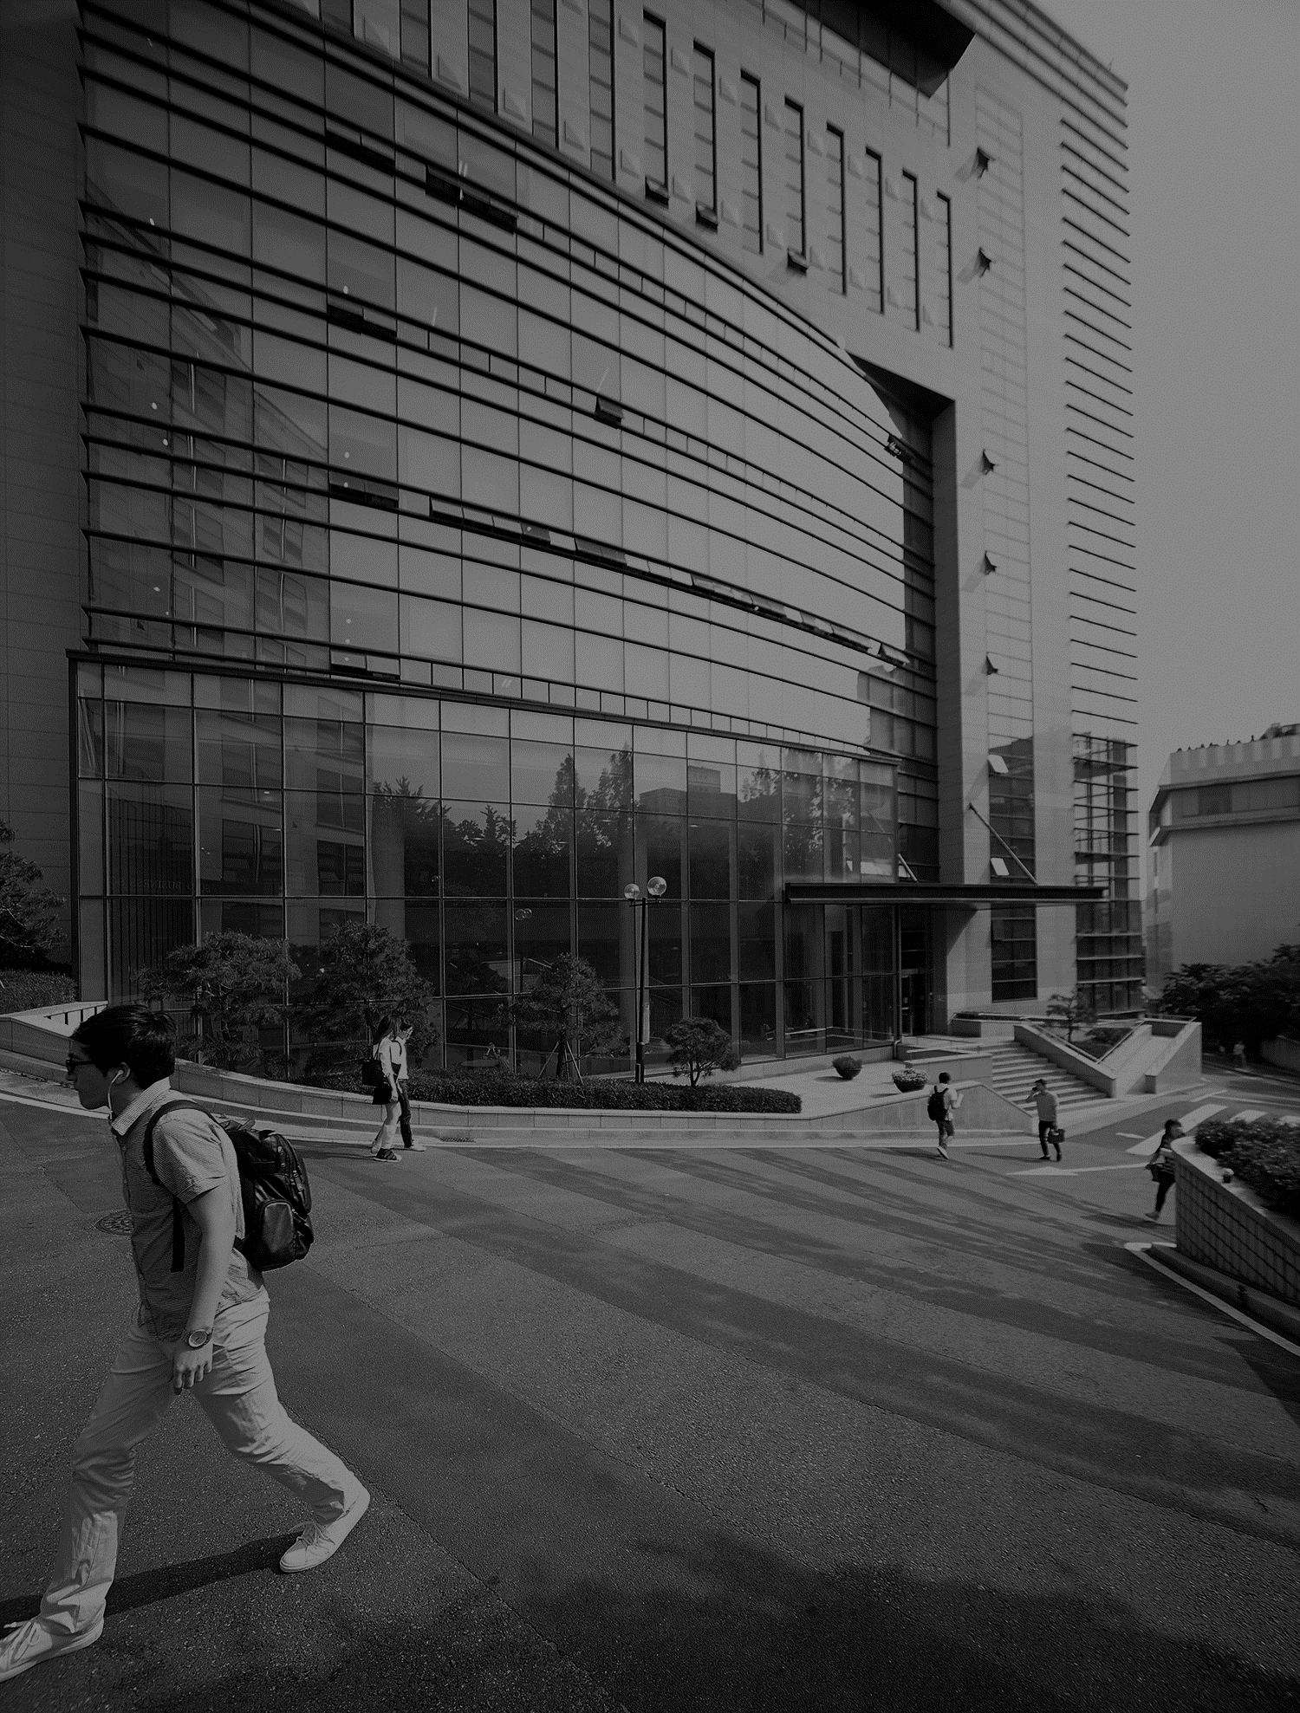
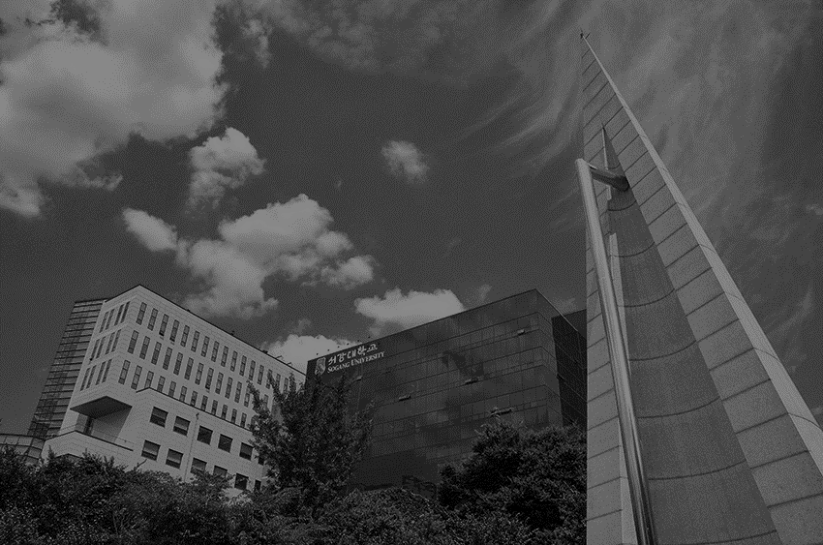
Week2 Measuring Weight and Volume

Slide 2


Purpose
Learn how to use scale and liquid transfer equipment, as well as how to process experimental data and estimate uncertainty

Slide 3
Theory
Weight, Mass, Density, Volume
Liquid Volume Measurement Apparatus
Measurement of Solid Volume
Solubility, Melting Point
Error, Uncertainty
Significant Figures

Slide 4
Chemicals & Apparatus
Chemicals
Name | Molecular formula | Molecular weight (g/mol) | Melting point(℃) | Boiling point(℃) | Density(g/cm³)
Water | H₂O | 18.02 | 0 | 100 | 1
Hexane | C₆H₁₄ | 86.18 | -95.3 | 68.7 | 0.66
Methylene chloride(MC) | CH₂Cl₂ | 84.93 | -96.7 | 39.3 | 1.33
Biphenyl | C₁₂H₁₀ | 154.21 | 69.2 | 255 | 1.04
Acetamide | C₂H₅NO | 58.08 | 79-81 | 221.2 | 1.16
Acetone | C₃H₆O | 58.08 | -94.9 | 56.08 | 0.78
Aluminum | Al | 26.98 | 660.32 | 2470 | 2.70

Slide 5
Chemicals & Apparatus
Apparatus
Experiment
A. Weight Measurement | Acetamide, Scale, Weighing Paper
B. Transferring Liquid Using a pipette | Scale, Distilled Water, Beaker(100mL) | Pipette (10mL), Pipette Filler
C. Transferring Liquid Using a Graduated cylinder |  | Graduated Cylinder (10mL)
D. Transferring Liquid Using a Buret |  | Buret (50mL), Stand, Clamp
E. Determining the Solubility of a Compound | Biphenyl, Acetamide | Test Tube , Distilled Water, Hexane
F. Determining the Melting Point of a Compound |  | Capillary Tube, Melting Point Apparatus
G. Determining the density of a Compound | Graduated cylinder (10mL), MC, Al, Hexane

Slide 6
Procedure
A. Weight Measurement
1. Examine the measured capacity (maximum measured weight) and precision of the scale to be used in the experiment.
2. Measure the weight of 1g of acetamide.
< How to use the scale >
Place a weighing paper on the plate and tare the scale.
Check the mass when the scale reading remains stable for 3 seconds, and record it.

Slide 7
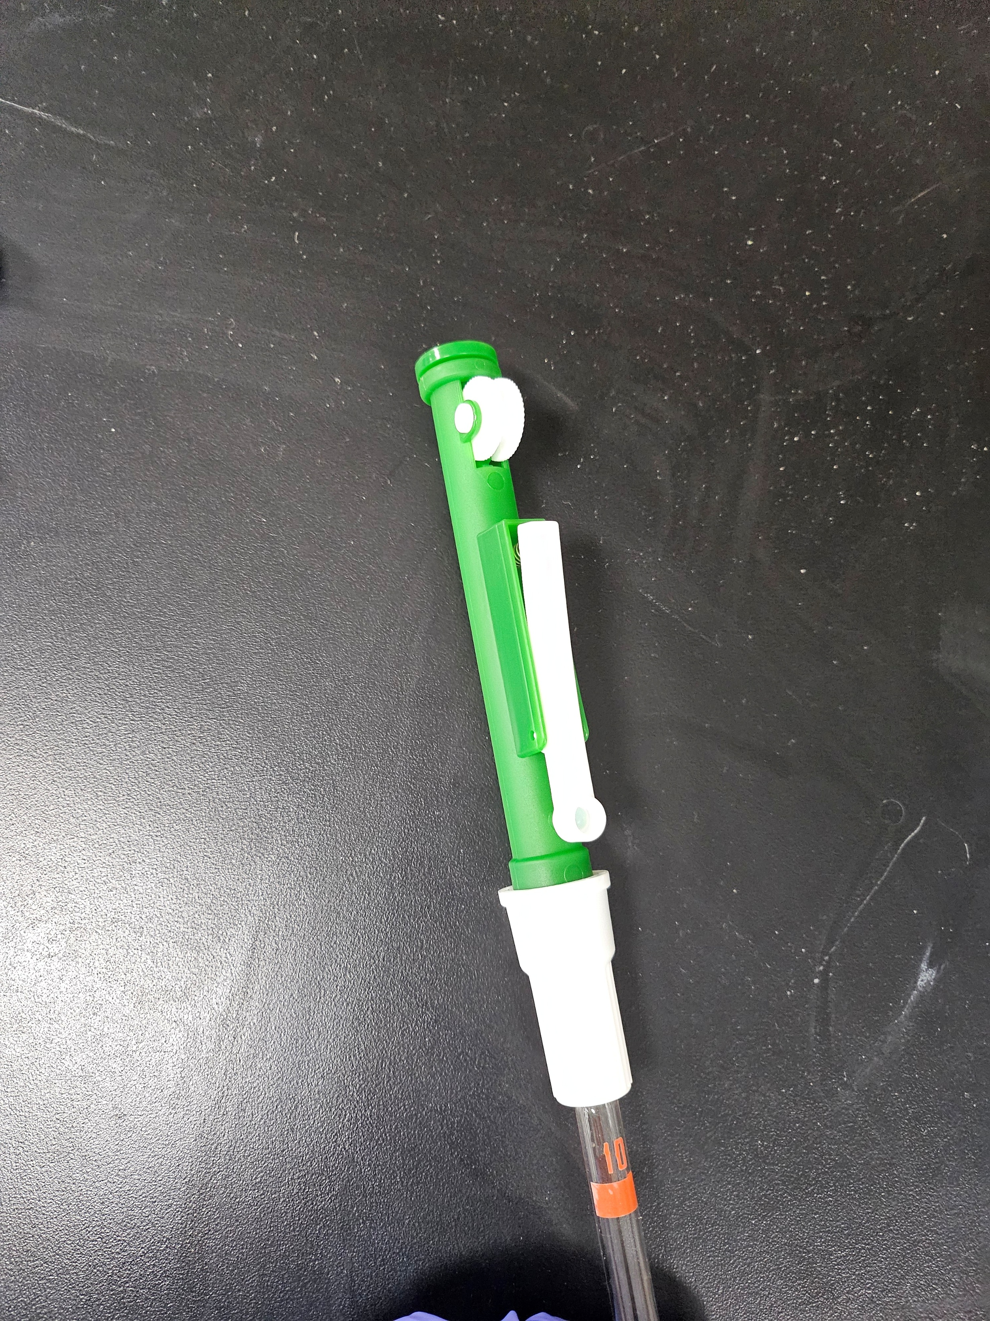
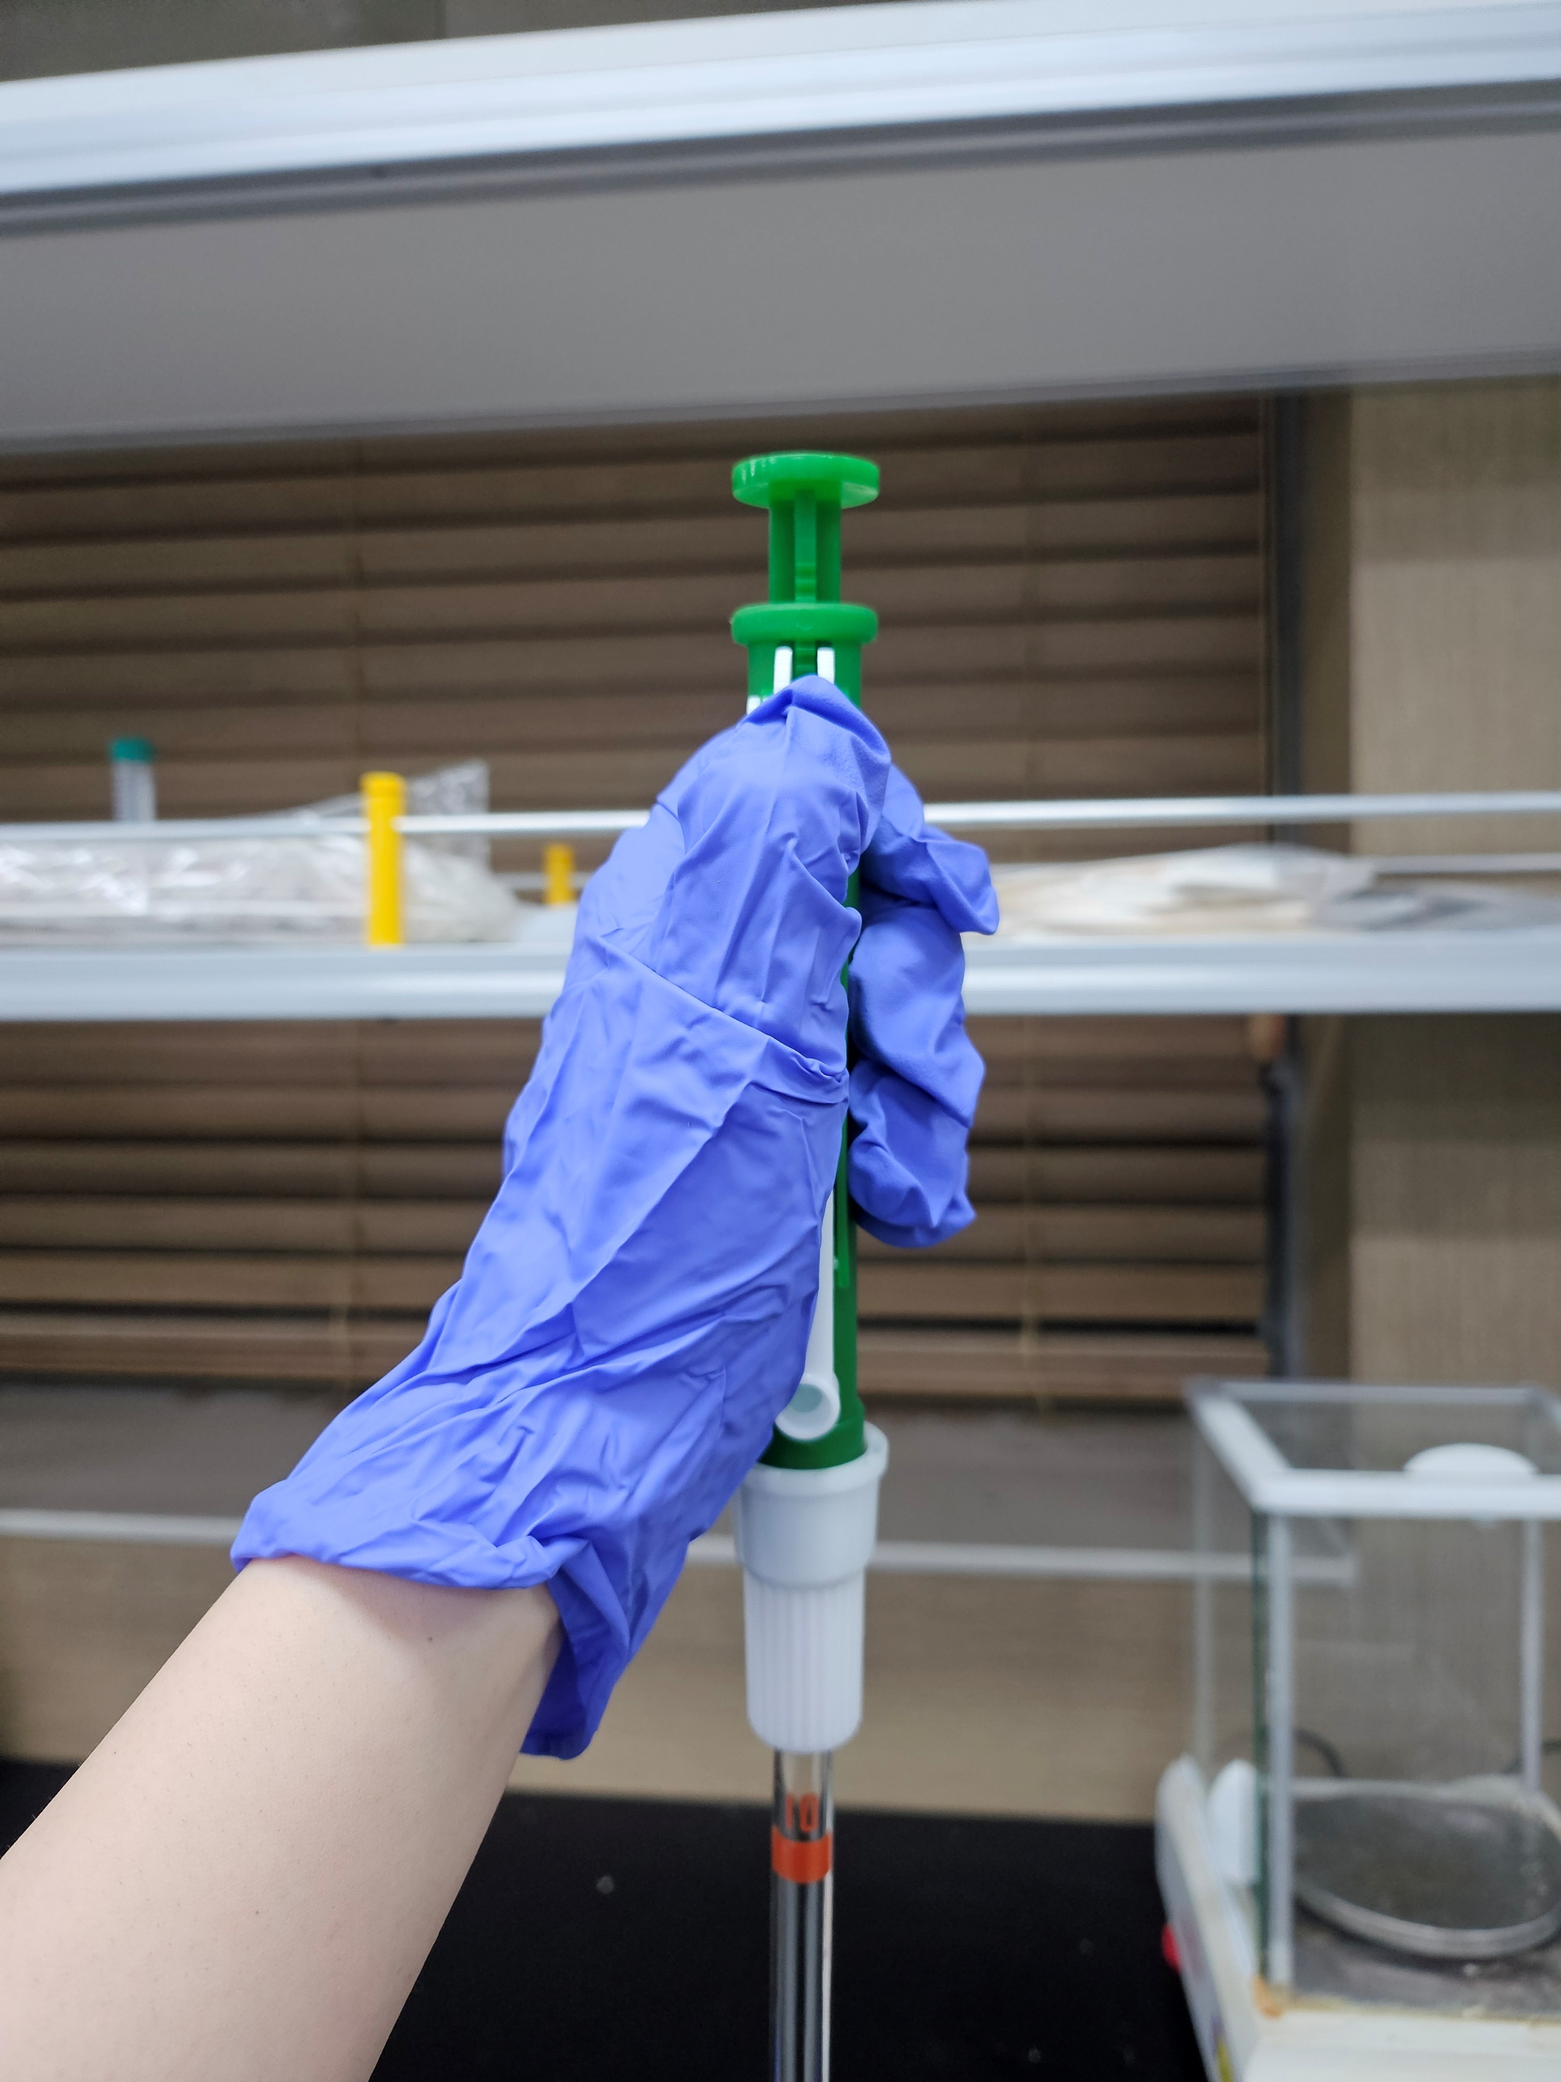
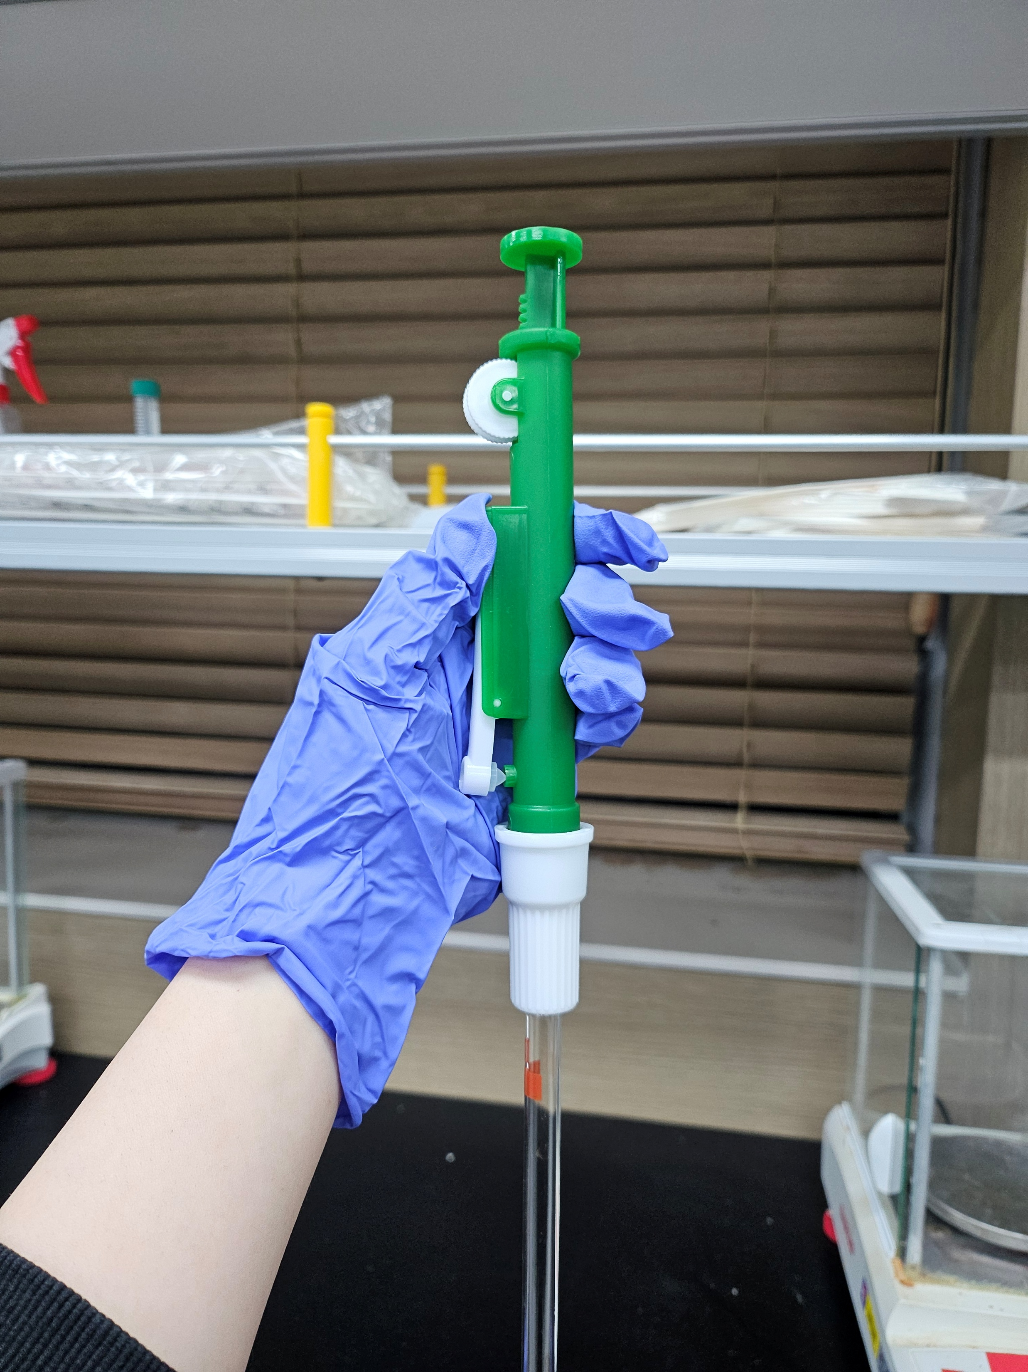
Procedure
B. Transferring Liquid Using a pipette
Place the beaker on the scale and measure its weight.
(Repeat twice) Transfer 10 mL of distilled water into the beaker using a pipette and measure its weight.
Using the density of water, calculate the average volume and standard deviation (uncertainty) of the distilled water.
pipette
When taking liquid
When removing liquid

Slide 8
Procedure
C. Transferring Liquid Using a Graduated cylinder
Place the beaker on the scale and measure its weight.
(Repeat twice) Transfer 10 mL of distilled water into the beaker using a graduated cylinder and measure its weight.
Using the density of water, calculate the average volume and standard deviation (uncertainty) of the distilled water.

Slide 9
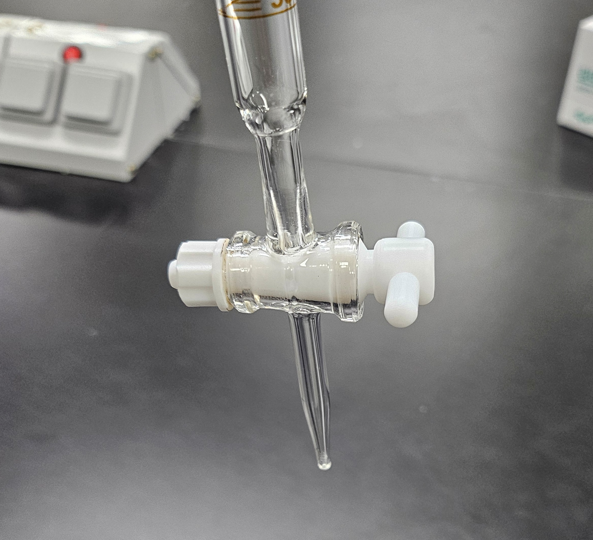
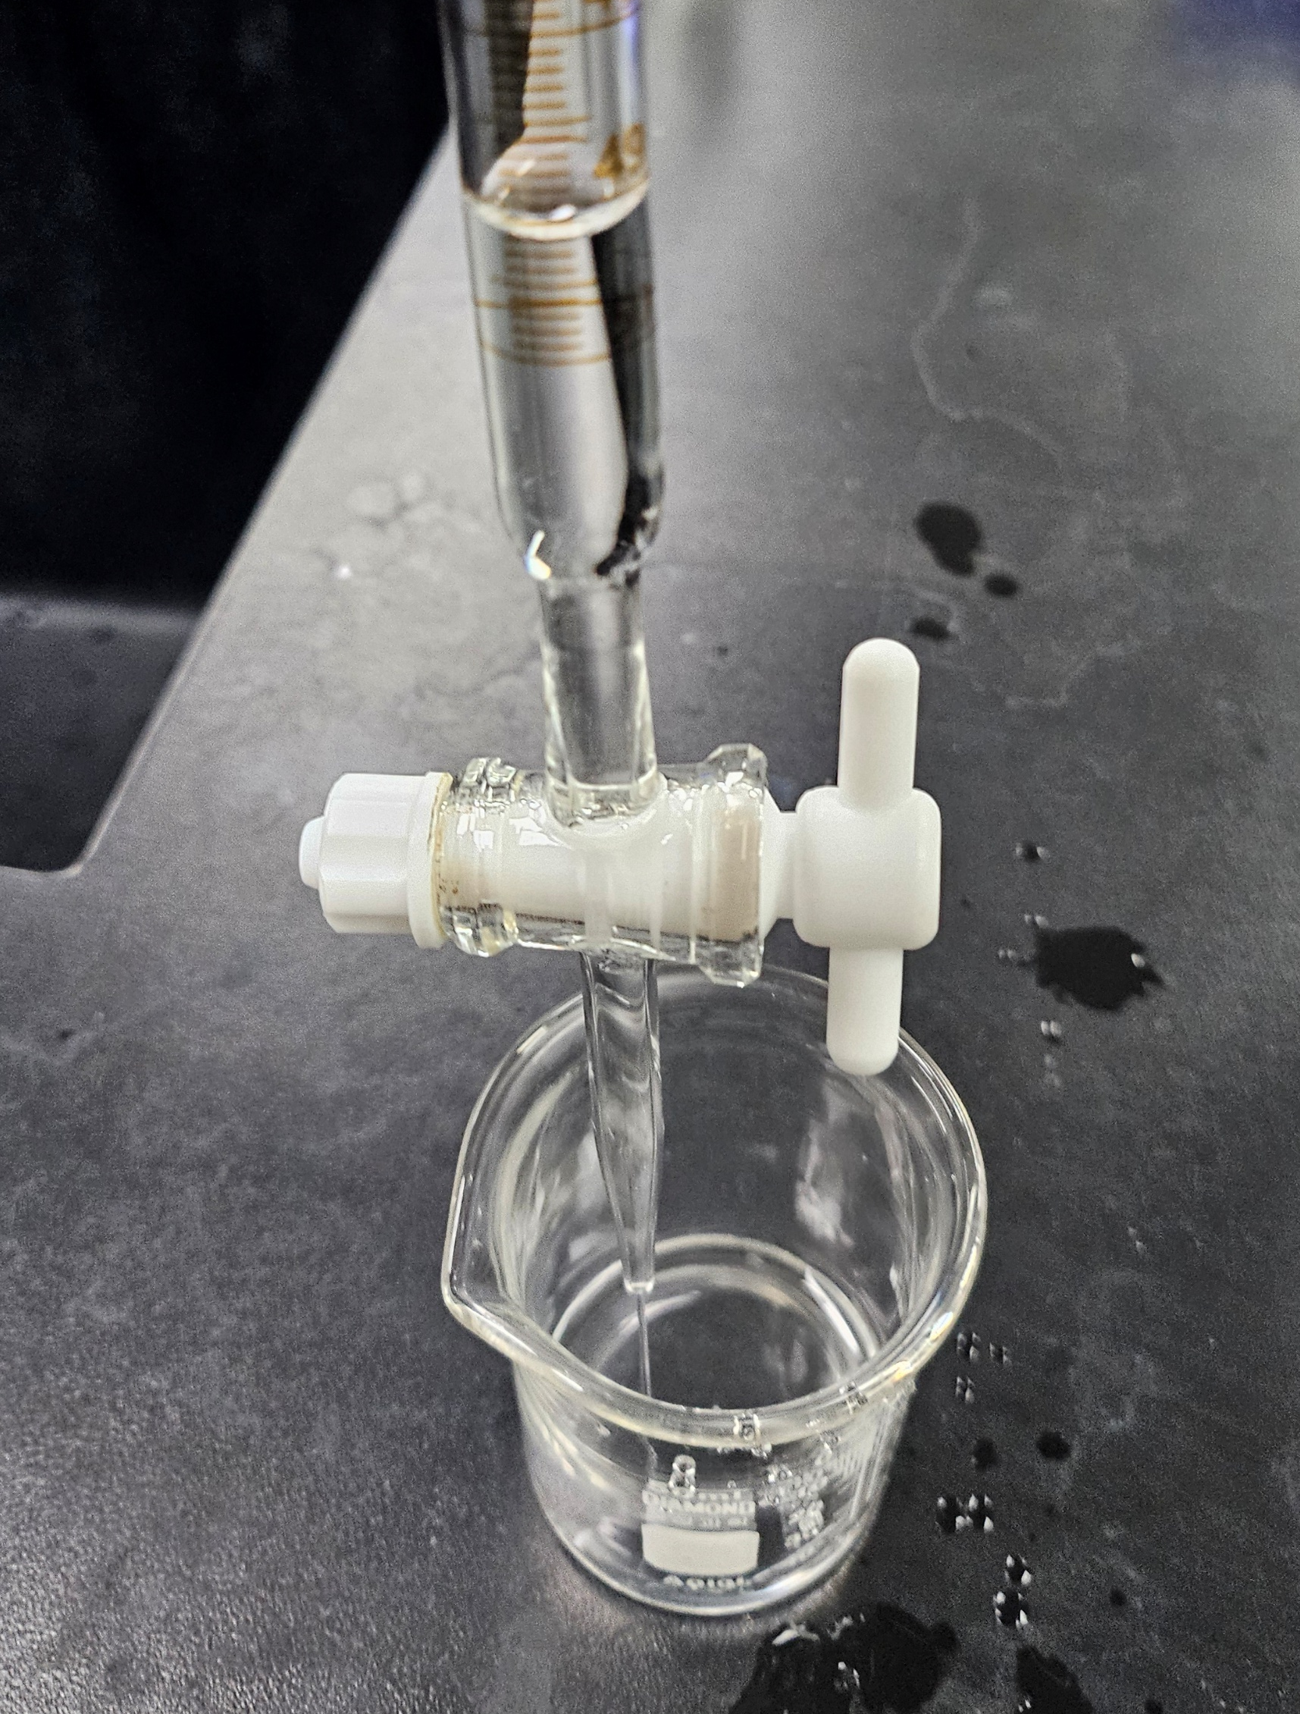
Procedure
D. Transferring Liquid Using a Buret
Place the beaker on the scale and measure its weight.
(Repeat twice) Transfer 10 mL of distilled water into the beaker using a buret and measure its weight.
Using the density of water, calculate the average volume and standard deviation (uncertainty) of the distilled water.
Closed state
Open state
When removing liquid

Slide 10
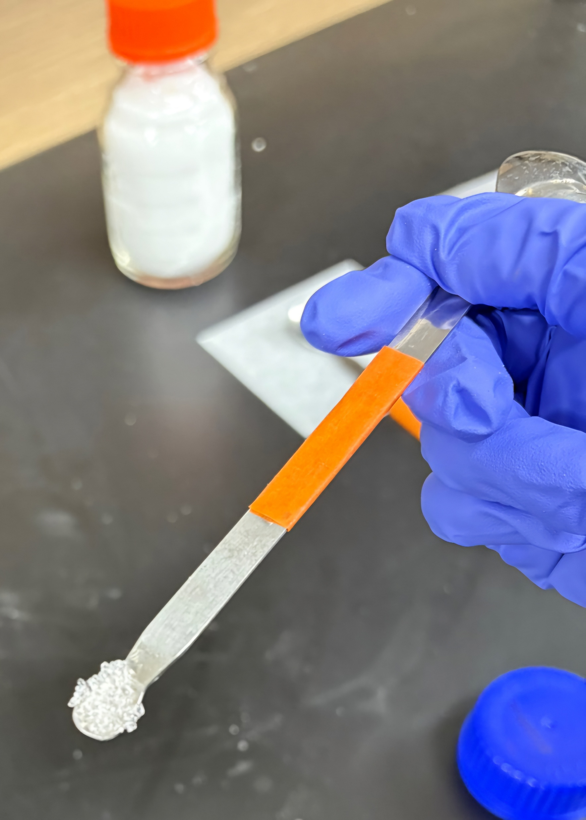
Procedure
E. Determining the Solubility of a Compound
Add one small spatula scoop of acetamide into the test tube.
Add distilled water and n-hexane into the test tube to a height of 1–2 cm from the bottom.
Shake the test tube well for about 5 minutes and observe the state.
Record the experimental results as S (Soluble) or I (Insoluble).
Determine the solubility of biphenyl using the same method as in steps 1 to 4.

Slide 11
Procedure
F. Determining the Melting Point of a Compound
Tap the melting point capillary tube into biphenyl 4 to 5 times *If the reagent is too clumpy, press and crush it with a spatula to fill the capillary tube.
Lightly tap the end of the capillary tube on the desk to help fill it with powder.
Place it in the melting point apparatus and measure the melting point.
Determine the melting point of acetamide using the same method as in steps 1 to 3.

Slide 12
Procedure
G. Determining the density of a Compound
Check the density of methylene chloride (MC)
Place the graduated cylinder on the scale and measure its weight.
Fill the graduated cylinder with 10 mL of MC and measure its weight.
Check the density of aluminum
Weigh the two aluminum pieces.
Add 5 mL of n-hexane to the graduated cylinder, then place the two pieces of aluminum in it and measure the volume change. (Do not discard the aluminum)

Slide 13
Data & Results
A. Weight Measurement
Maximum Measurement Weight | precision | Acetamide Weight
B. Transferring Liquid Using a pipette
 | Group Member 1 | Group Member 2 | Average
The weight of 10 mL of distilled water
Actual volume of water (mL)

Slide 14
Data & Results
C. Transferring Liquid Using a Graduated cylinder
 | Group Member 1 | Group Member 2 | Average
The weight of 10 mL of distilled water
Actual volume of water (mL)
D. Transferring Liquid Using a Buret
 | Group Member 1 | Group Member 2 | Average
The weight of 10 mL of distilled water
Actual volume of water (mL)
- 물의 밀도 = 0.99705 g/mL (25℃)
- 부피 불확정도 ≈ 0.027 mL

Slide 15
Data & Results
E. Determining the Solubility of a Compound
 | Water | n-Hexane
Acetamide
Biphenyl
F. Determining the Melting Point of a Compound
 | Melting point measurement
A : Acetamide (79~81 °C)
B : Biphenyl (69.2 °C)

Slide 16
Data & Results
G. Determining the density of a Compound
1) MC (Theoretical value : 1.33g/mL) | 13.353 g
Weight of 10 mL of MC
MC density experimental value
2) Aluminum (Theoretical value : 2.70g/mL) | 13.353 g
Al Weight
Volume change of n-Hexane
Al density experimental value

